Slide 1
Claims, Evidence and Reasoning
Why it matters

Slide 2
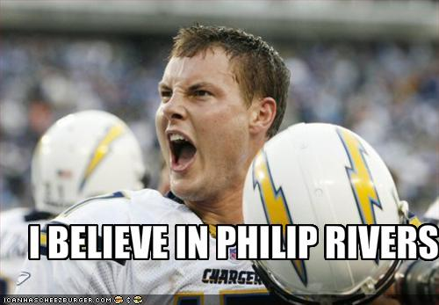
Claims, Evidence and Reasoning
Phillip Rivers is the best quarterback because he threw 30 touch downs last season. Not many quarterbacks throw that many touchdowns in a season.

Slide 3
Claim
What was the claim?
“Phillip Rivers is the best quarterback.”
Claim: makes an assertion or conclusion that addresses the original question or problem about a phenomenon.

Slide 4
Evidence
Did I offer any evidence?
“He threw 30 touchdowns last season.”
Evidence: Supports the claim using scientific data. It needs to be both appropriate and sufficient.

Slide 5
Reasoning
What reasoning was offered?
“Not many quarterbacks throw that many touchdowns in a season.”
Reasoning: links the claim and the evidence and shows why the data counts as evidence to support the claim.

Slide 6
What was your paragraph missing?
Rewrite your warm up paragraph using your favorite band/singer.
Label the CLAIM, EVIDENCE and REASONING parts of your paragraph.

